Slide 1
Unknown
26%
IOS, iPhone or iPad
26%
Windows NT 2%
Mac OS X 10.x
12%
Widows 7 or 8
16%
Windows XP
0% (1 user)
Android / Linux
18%

Slide 2
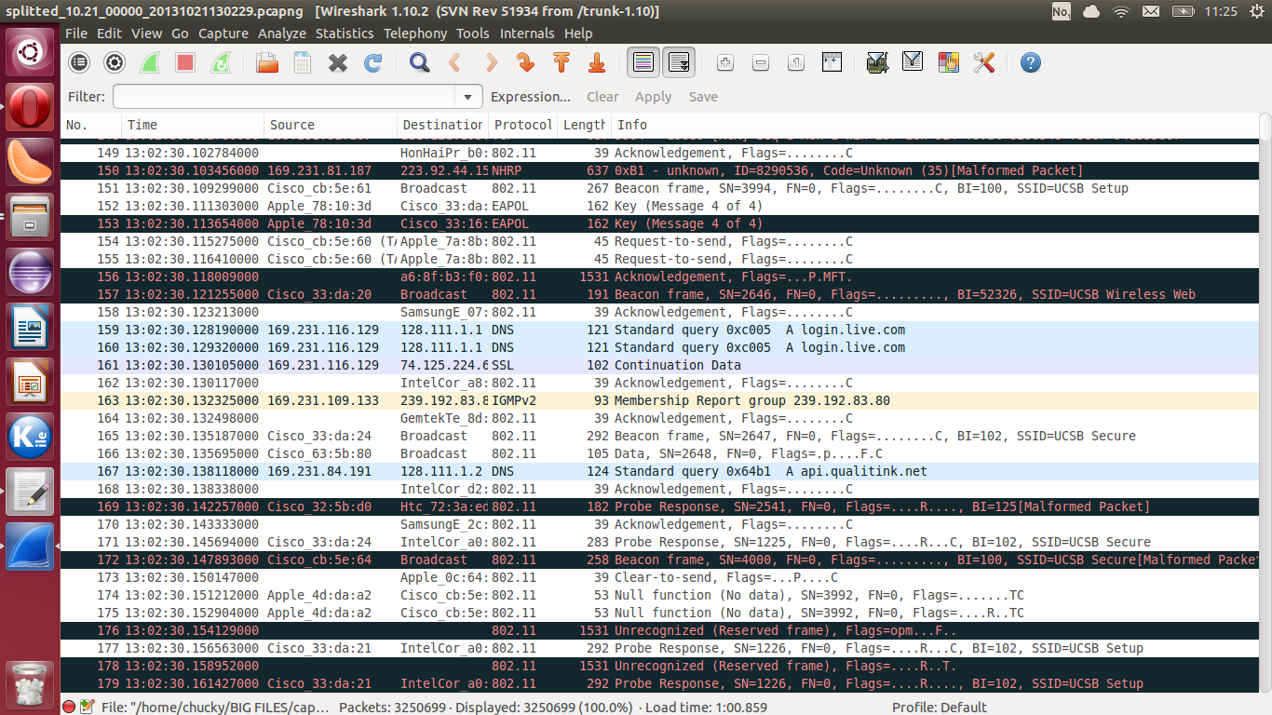
Data packet

